Slide 1

Composition vs. Inheritance

Slide 2
Question
What are game objects?
2

Slide 3
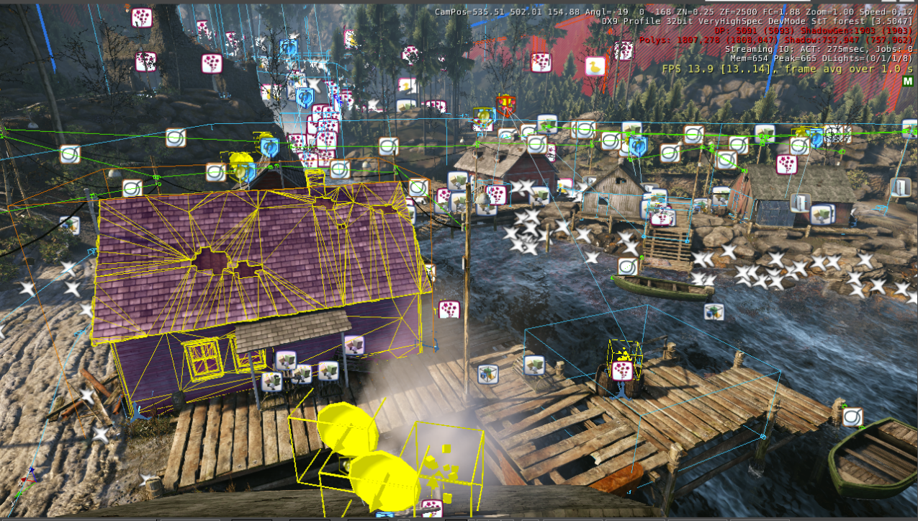
What are “game objects”?
Renderable
Enemies
Players
Pick-ups
Props
Projectiles
Vehicles
Scenery
Non-renderable
Waypoints
Volumes
Triggers
Sounds
3

Slide 4
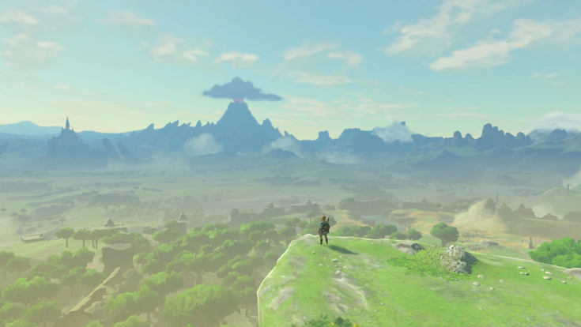
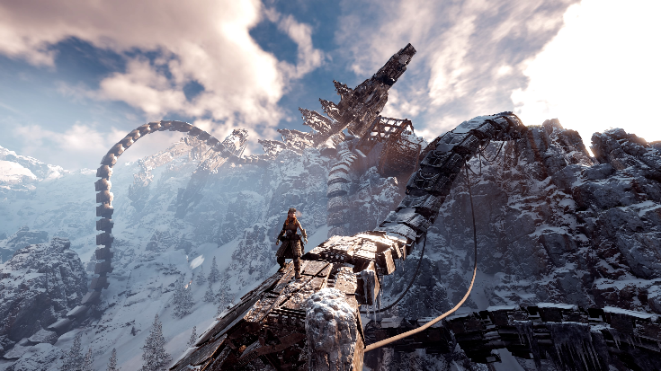
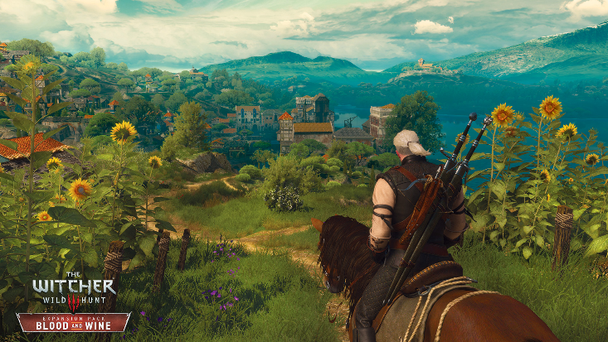
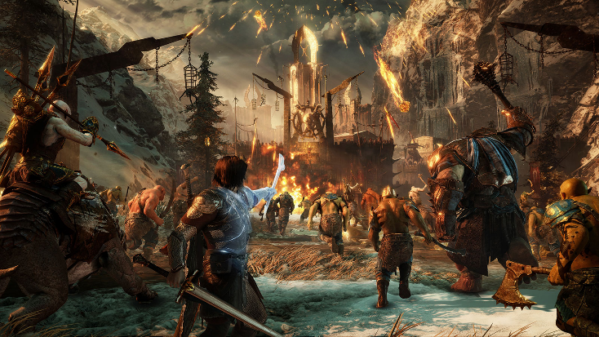
Games are getting big…
Games worlds are getting bigger and bigger…
Proper management of game objects (also known as entities) is essential and helps solve some of the every day problems of game development.
How do we structure our entities so we can add new functionality easily?
How do you efficiently update and draw thousands of entities?
How do you find a specific entity out of hundreds or even thousands?
How do you send data between two separate entities?
4

Slide 5
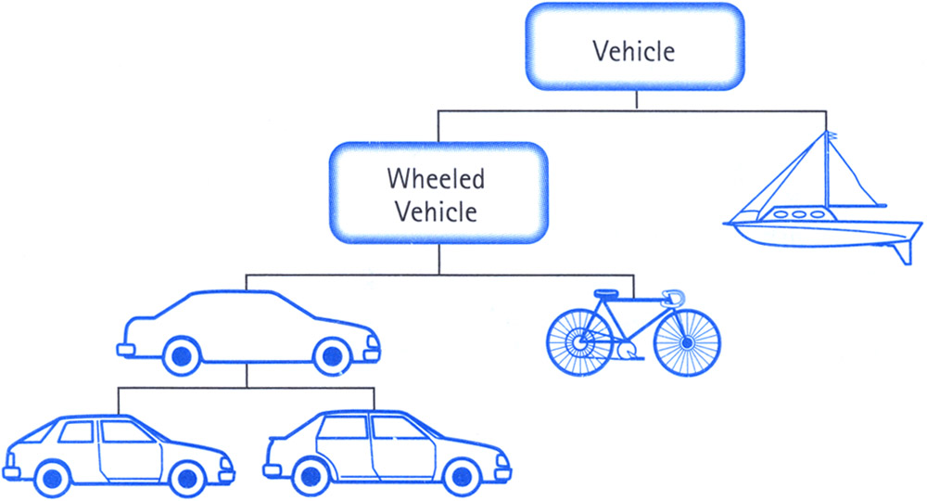
Inheritance
Inheritance is when one class inherits functionality from its parent (or “base” class).
Many game engines build large hierarchies of inherited classes.
It is a natural way to classify game objects: taxonomically (i.e. via an ordered system of relationships).
This approach allows base classes to house generic functionality that is used by all child classes below it in the hierarchy.
And for child classes to house logic unique to that class.
5

Slide 6
Limitations of inheritance
Inheritance hierarchies can grow to a point where they are difficult to manage, these are often referred to monolithic hierarchies.
No (good) way to tell if a certain game object derives from a particular base class.
Classes are tightly coupled, changing anything in a base class could have serious repercussions to the derived classes.
Tough to maintain and update, in order to implement a new derived class we have a lot of virtual functions to implement before we can write any actual logic.
Games change and evolve rapidly in development, making it less suited to the inflexible nature of large inheritance hierarchies.
Entity
Trigger Volume
Renderable
Static Scenery
Animated
Animated Scenery
Actor
Player
Enemy
= abstract
Grunt
Elite
= concrete
6

Slide 7
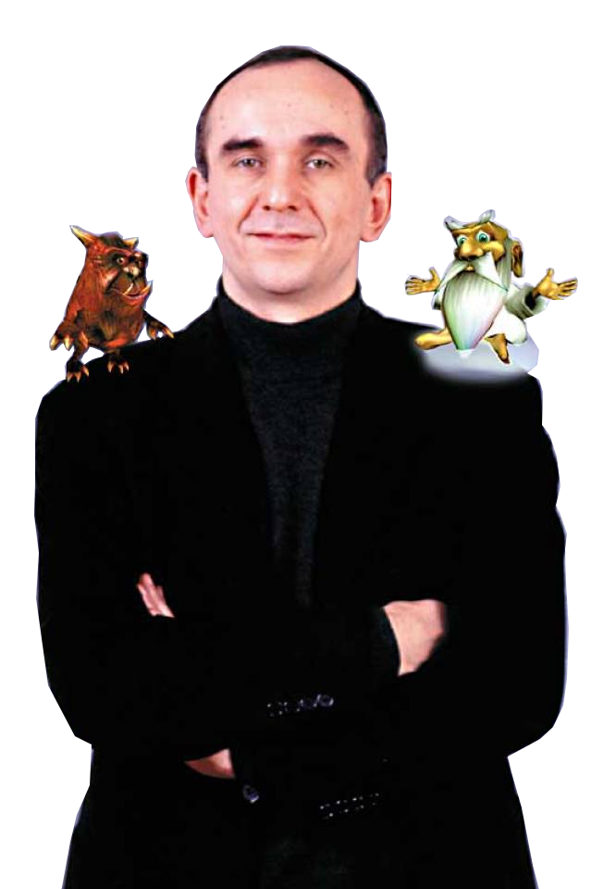
A common problem…
Guys, I know we’re 12 months into development…
But I have a great idea for a completely new game feature!
7

Slide 8
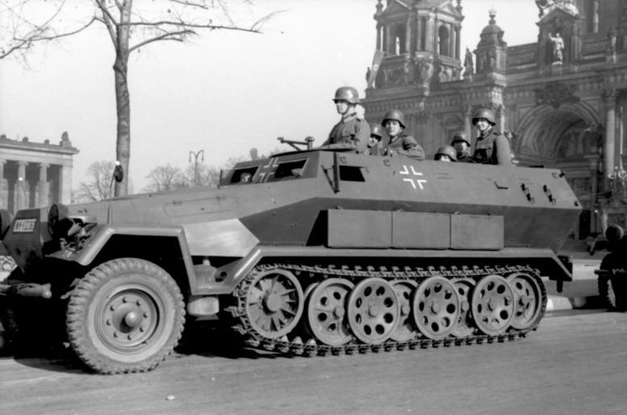
An example
Entity
???
Actor
Vehicle
Truck
Tank
Troop Transport
Tiger
Panzer
8

Slide 9
Multiple Inheritance
One potential way to solve the previous problem is through Multiple Inheritance.
Allowing one class to have inherit from two parent classes.
One problem with that is an object can have multiple copies of its base class’ members.
Most studios prohibit MI, in fact once again a lot of more modern programming languages don’t allow MI.
Some teams permit multiple parent classes as long as the there is only one grandparent.
This is often referred to as “The Deadly Diamond”.
Vehicle
Truck
Tank
HalfTrack
= abstract
= concrete
9

Slide 10
The “Is-A” Relationship
Deep monolithic hierarchies overuse the “Is-A” relationship:
i.e. This entity is a Vehicle
i.e. This entity is a Tank
The more complex the game becomes the more code we need to share between two or more unrelated classes. This causes features to “bubble up” the hierarchy:
In the case of the previous problem, functionality from the Truck and Tank classes may have to “bubble up” to the parent class (Vehicle).
This allows our new HalfTrack class to have access to the required functionality.
Entity
Actor
Vehicle
HalfTrack
Truck
Tank
Troop Transport
Tiger
Panzer
10

Slide 11
Question
How do we solve this problem?
11

Slide 12
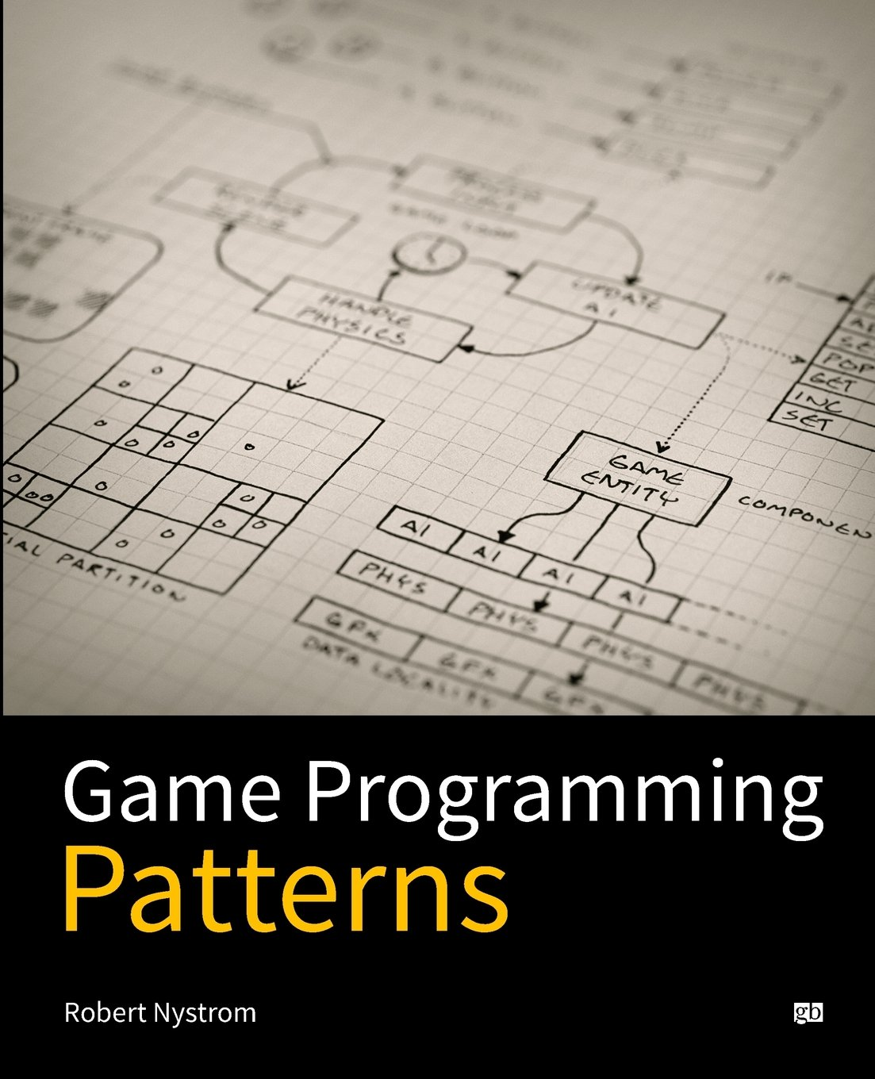
Design Patterns
Many of the architecture design problems we face are not unique to game development, they apply to all software development.
In fact, these kinds of problems are so common that generic Software Design Patterns exist to help solve them.
These patterns are “best practice” solutions to help you build robust and reusable code.
Many resources are available on design patterns but Robert Nystrom’s Game Programming Patterns is a great place to start.
One pattern is commonly used to solve the problem of monolithic hierarchies is the Component Pattern.
12

Slide 13
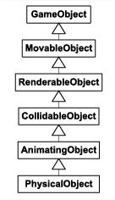
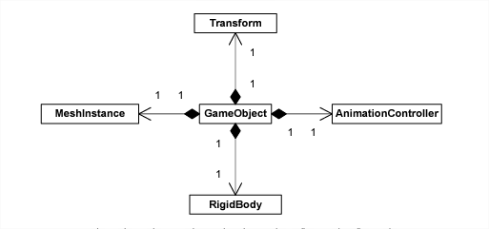
Component Pattern
The Component Pattern is a structural/architectural design pattern which uses a has-a relationship between classes.
In order to reduce the complexity of a monolithic hierarchy we can convert some of the is-a relationships to has-a.
A class either contains an instance of a component or a pointer/reference to it.
Each component provides certain additional functionality:
The Transform holds our 4x4 Matrix.
AnimationController contains our skeletal joint hierarchy.
RigidBody allows the object to be part of the physics simulation.
MeshInstance holds our 3D Model.
13

Slide 14

Component Systems
Entity
Often referred to as Entity Component Systems, this is a very popular paradigm in game development due to its flexibility.
Our entity object becomes a (mostly) empty container to house our components.
And each component created adds additional behaviour or functionality to an entity.
The components themselves add the functionality to our entity.
Render Component
Animation Component
Vehicle Component
14

Slide 15
Solving our Problem
Inheritance
Composition
Entity
Tank
Truck
Half-Track
Entity
Entity
Render Component
Entity
Render Component
Render Component
Vehicle
Physics Component
Physics Component
Physics Component
Tracked Vehicle Component
HalfTrack
Truck
Tank
Tracked Vehicle Component
Wheeled Vehicle Component
Wheeled Vehicle Component
Troop Transport
Tiger
Panzer
15

Slide 16
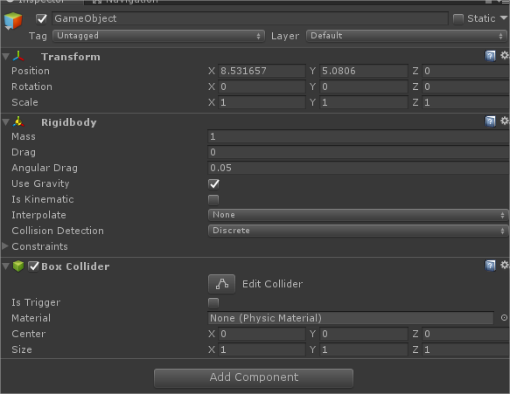
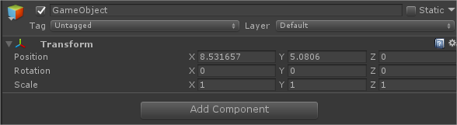
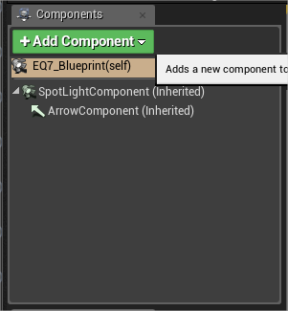
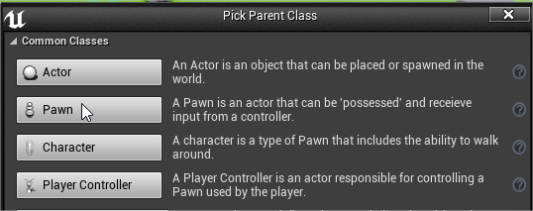
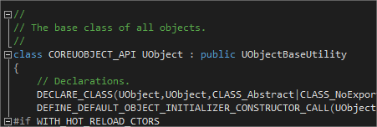
Components in Modern Game Engines
You should be fairly familiar with this concept already from Unity/UE4.
Creating an Empty Game Object in Unity gives you this.
Essentially an (almost) empty container with just a transform component.
From that point you add further components for additional functionality.
Similarly in UE4 creating a new blueprint allows you to plug in various other components.
That’s not to say either of these engines totally prohibit inheritance all of the common classes share parents/grandparents..
Following the inheritance hierarchy back in the code you get back to this UObject base class.
16

Slide 17

Unity Entity Component System Showcase
17

Slide 18
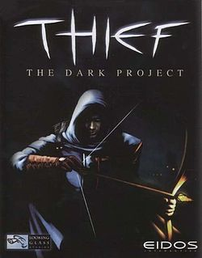
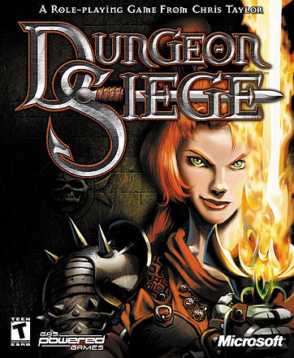
This is not a new idea
One of the earliest examples of an ECS system in games is Thief’s implementation in 1998.
Additionally there is another well documented implementation for Dungeon Siege in 2002.
The implementations themselves vary in certain specific details.
But they all focus on the ‘Has-A’ relationship of an ECS.
Thief: The Dark Project
Looking Glass Studios (1998)
Dungeon Siege
Gas Powered Games (2002)
18

Slide 19
Component Systems in Review
Benefits
A very popular paradigm in modern game engines
Much less rigid, our logic is no longer tightly coupled
This de-coupling makes our components easier to test and understand
Drastically reduced our hierarchy down
We now have the ability to genericise our components
Various options for communication between components:
By modifying the container (i.e. the owner entity)
By referring directly to other components
By sending messages
Drawbacks
Systems will be iterating over relevant components or lists of entities, this may require optimisations when the element list gets particularly large.
Additionally tasks which need to synchronise separate components often end up having to hold duplicate data.
Difficult for developers to leave behind the “inheritance” paradigm (i.e. fear of change).
19

Slide 20
Further Study
The Entity-Component-System - An awesome game-design pattern in C++ by Tobias Stein
https://www.gamasutra.com/blogs/TobiasStein/20171122/310172/The_EntityComponentSystem__An_awesome_gamedesign_pattern_in_C_Part_1.php
Component - Game Programming Patterns by Robert Nystrom
https://gameprogrammingpatterns.com/component.html
A Data-Driven Game Object System by Scott Bilas
https://www.gamedevs.org/uploads/data-driven-game-object-system.pdf
Entity-Component-System, Wikipedia
https://en.wikipedia.org/wiki/Entity_component_system
20

